Slide 1
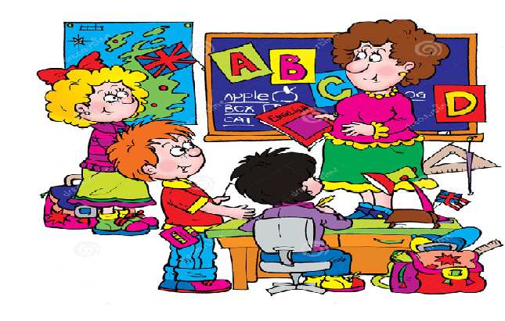
Welcome to our English class!

Slide 2

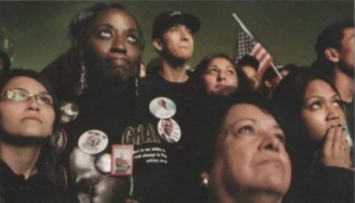

Task 1: Look at the photo and answer the questions
1. Who can you see?
3. How do they feel?
2. What are the people doing?

Slide 3

What’s happening?
People are looking at a screen in Chicago to see if Barack Obama has won the election on November 4, 2008.
moment (n): /'məʊmənt/ very short period of time

Slide 4

Task 1: Reorder the paragraphs to make a complete text
A MOMENT IN HISTORY
ANSWER
I - E - C - H - D - G- B - A - F

Slide 5
Read the text again. Choose the best summary
A. Tom Pilston went inside the convention center in Chicago to photograph Obama. He felt so happy to hear the election results from the radio.
B. Tom Pilston arrived in Chicago and took a lot of photographs of Obama and his family. He had a chance to see people showing their love to the new president.
C. Tom Pilston went to Chicago to take the photographs of Obama and his family. He couldn’t go inside the center. Then, he had a chance to see people with different kinds of feelings listening to the election results.
C. Tom Pilston went to Chicago to take the photographs of Obama and his family. He couldn’t go inside the center. Then, he had a chance to see people with different kinds of feelings listening to the election results.

Slide 6



vocabulary
photograph (n) /'fəʊtəgra:f/ = photo:
=>
a picture made by a camera
take a photograph of sb/sth
=> photographer (n): /fə'tɒgrəfə(r)/
a person who takes a photograph

Slide 7
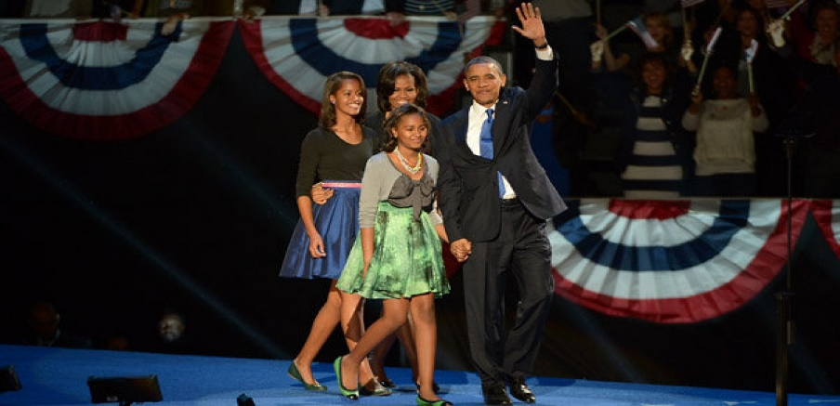
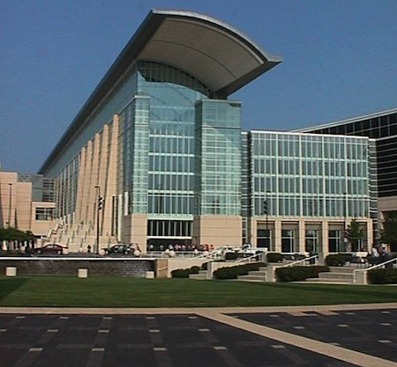
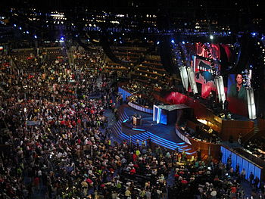
vocabulary
convention (n): /kən'venʃn/
an official agreement between
countries or leaders.
=> convention center (n)

Slide 8
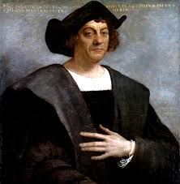
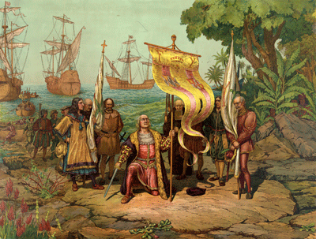
vocabulary
discover (v): /dɪ'skʌvə(r)/
to find out about something
for the first time
Christopher Columbus discovered America on 12th October, in 1492.

Slide 9

vocabulary
press (n): /pres/
- people (reporters and photographers)
for newspapers or magazines
- newspapers, magazines and radio
and TV news reports
Pass (n): /pa:s/
An official document
that shows you have the right
to enter or leave a place.
=> A bus pass, boarding pass
Press pass (n)

Slide 10
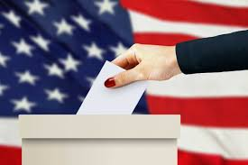

vocabulary
election (n) /ɪ'lekʃn/
the process of choosing a person or a group of
people for a position, especially for a political
position by voting.
=> elect (v)

Slide 11
vocabulary
result (n): /rɪ'zʌlt/
a thing that is caused or produced
because of something else.
E.g: He made a big mistake.
As a result, he lost his job.

Slide 12
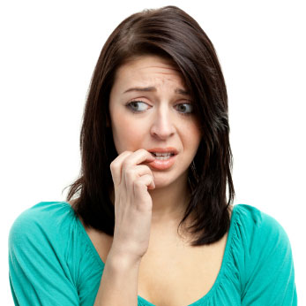
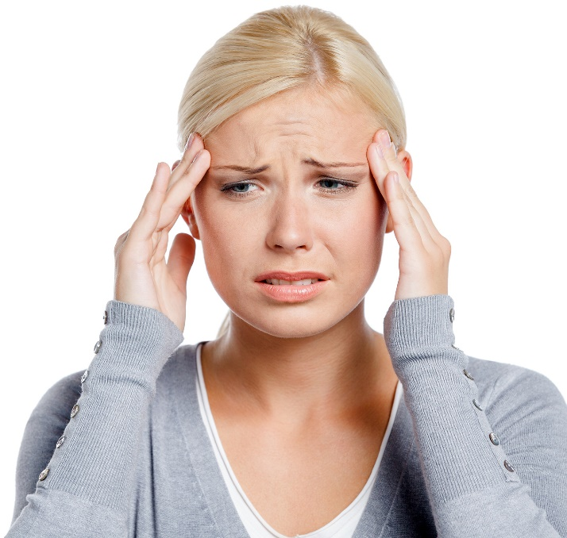
vocabulary
nervous (adj): /'nɜ:vəs/
worried or afraid of what might happen
e.g: She feels nervous because of the exam.
tense (adj): /tens/ nervous and not able to relax

Slide 13

vocabulary
announce (v): /ə'nəʊns/
officially tell people about something
=> announcement (n)

Slide 14
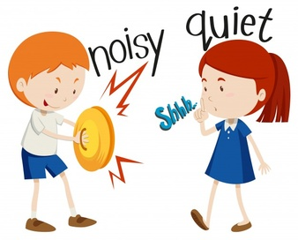
vocabulary
quiet (adj) /'kwajət/
making very little noise, not taking

Slide 15
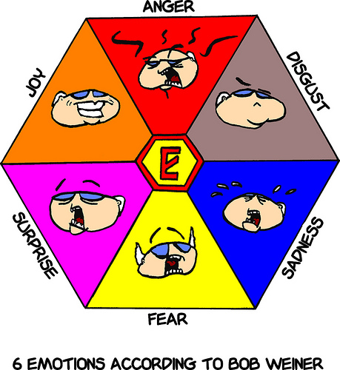
vocabulary
emotion (n) /ɪ'mouʃn/
a strong feeling (such as love, anger,
hate or fear)
=> emotional (adj)

Slide 16
Task 2: Read the text again and decide whether the following statements are True (T) or False (F).
Tom Pilston went to Chicago for holiday.
He couln’t take the photograph of Obama because he forgot his camera.
People were waiting to see Obama on the TV screens.
It wasn’t a cold night.
He took this photo inside the center.
People lost control of their feelings when Obama won the election.
F
F
F
T
F
T

Slide 18
Next term, they will be wearing a new uniform.
started
will finish
now
present
this term
The students are wearing an old uniform.
will start
will finish
future
next term
The students will be wearing a new uniform.

Slide 19
1. Next term, they will be wearing a new uniform.
Future Continuous
S
will be + V-ing
6p.m
now
9p.m
today
We are studying English at VUS.
6p.m
at this time
9p.m
next Thursday
We will be studying English at VUS.
=> An action in progress at a specific time in the future

Slide 20
Future Continuous
Task 2: Make sentences about what George will be doing at the times given.
7.15 | shower
7.50 | breakfast
8.40 | catch bus to school
8.55 | arrive at school
10.30 | maths lesson
=> At 7.15 tomorrow, he’ll be having a shower.

Slide 21
2. I’m flying to Hanoi tomorrow.
Future Continuous
=> I will do the activity in the near future.
I’ve already had a plan to fly to Hanoi.
=> I will be flying to Hanoi tomorrow.
=> to talk about planned events or events that we expect to happen.
=> Next term, we will be meeting more regularly.

Slide 22
Future Continuous
Task 3: Write sentences about these people’s plans.
1. I’m going to the supermarket later.
2. He’s visiting his grandparents next month.
3. She’s watching the football match on TV tonight.

Slide 23
3. When will you leave?
Future Continuous
=> Direct question
=> Can you let me know
when will you leave?
=> Can you let me know when you will leave ?
=> Can you let me know when you will be leaving ?
=> When will you be leaving ?
to make polite enquiries (ask about somebody’s plans politely)

Slide 24
Task 4: Rephrase the questions to make polite questions.
Future Continuous
1. What time are you leaving school?
=> What time will you be leaving school?
2. Are you going to stay overnight?
=> Will you be going to stay overnight?
3. What do you plan to do this evening?
=> What will you be doing this evening?

Slide 25
Future Perfect
4. By the end of the year, they will have made their school better.
S
will have + V-3/ -ed
started
now
They have made the school better.
now
the end of the year
past
present
future
They will have made the school better.
=> to talk about a completed action in the future

Slide 26
Future Perfect Continuous
5. By the end of this week, they will have been running
S
will have been + V- ing
the new school council for a whole term.
past
the end of this week
They will have run the school council for a whole term
now
the end of this week
past
present
future
They will be running the school council.

Slide 27
Future Perfect Continuous
a whole term
the end of this week
past
…will have run… for a whole term.
…will be running…
=> …will have been running for a whole term.
=> to say how long an action will have been in progress in the future => usually used with for + a period of time.

Slide 28

Task 3: Explain the meaning of these sentences
At 4p.m, we’ll watch the film.
At 4p.m, we’ll be watching the film.
By 4p.m, we’ll have watch the film.
By 4p.m, we’ll have been watching the film for an hour.

Slide 29
Practice: Grammar builder p.122

